Slide 1
Steps to deploy your project on eclipse using tomcat server and Oracle 10g Server

Slide 2
Software needed to run the project
Eclipse (Indigo)
Apache Tomcat 7.0
Oracle 10g

Slide 3
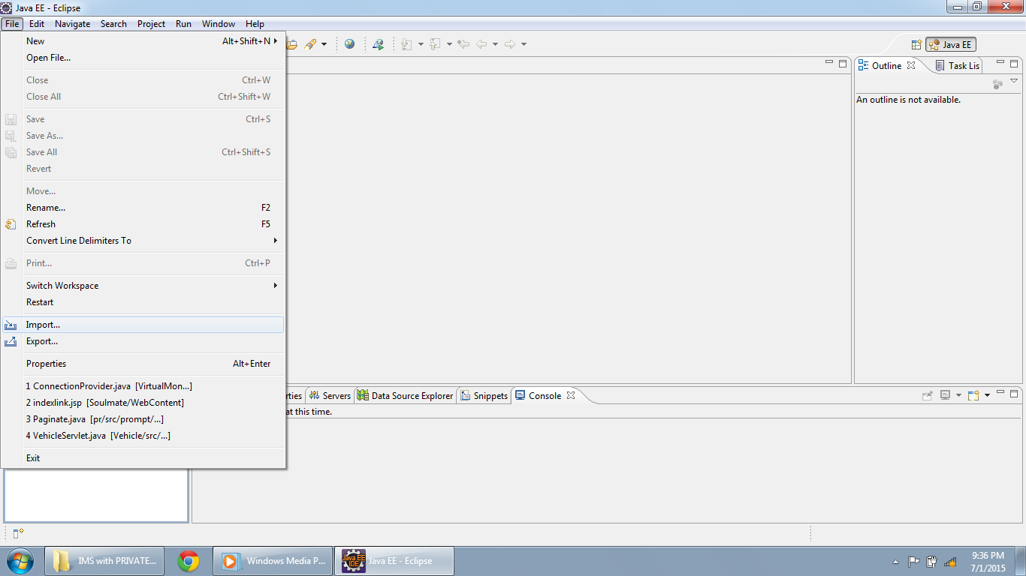
Open Eclipse and click on File>Import

Slide 4
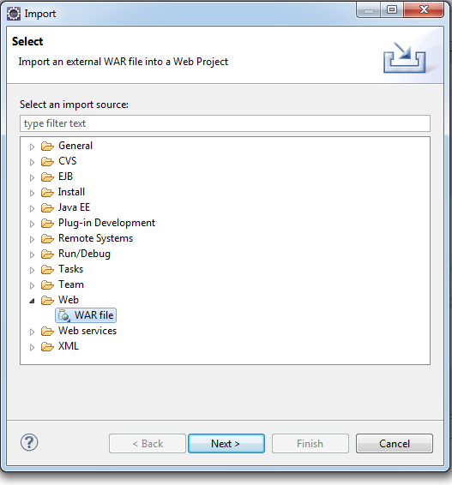
Select “War File” option in “Web”

Slide 5
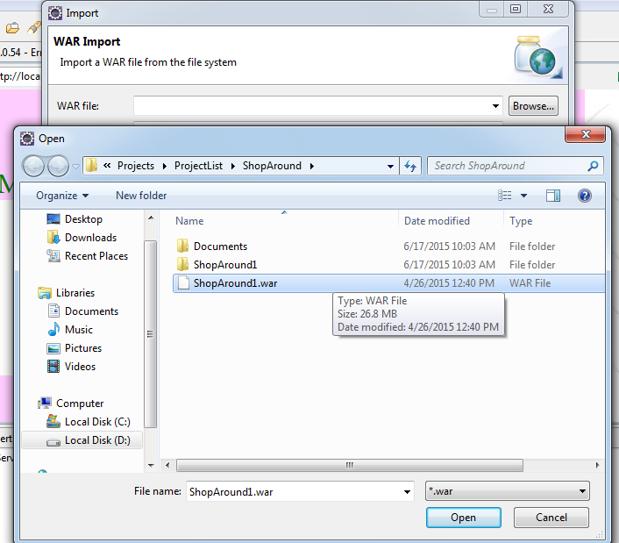
Browse to your war file and click finish

Slide 6
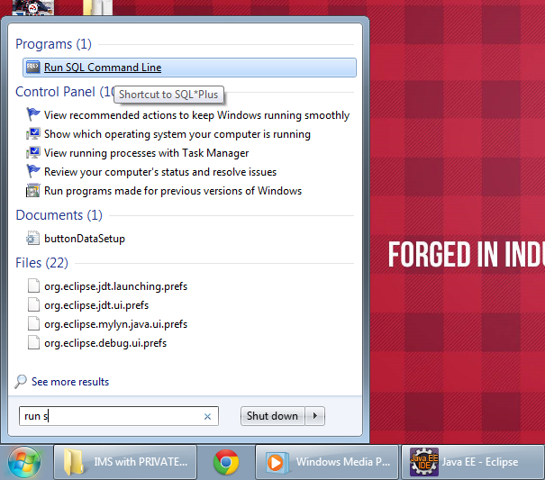
Open “Run SQL Command Line”

Slide 7
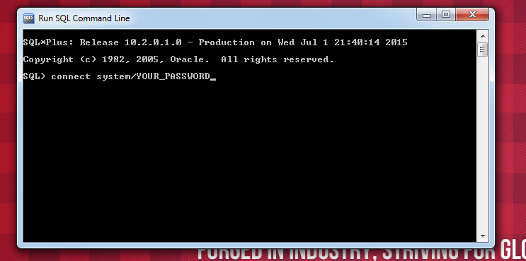
Type the password you chose while installing Oracle 10g in place of “YOUR_PASSWORD”

Slide 8
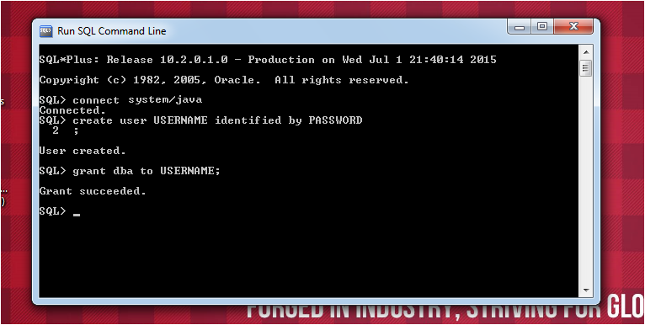
Every project has a unique username and password
For IMS the USERNAME is eshopping and the PASSWORD is nolin

Slide 9
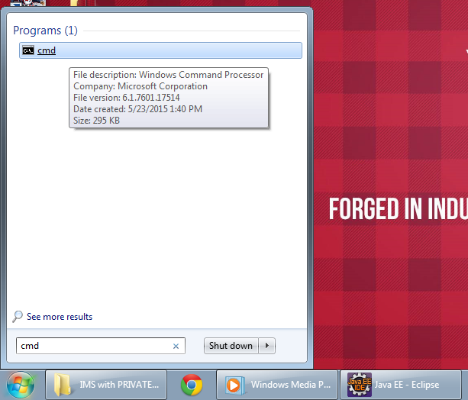
Open “cmd”

Slide 10
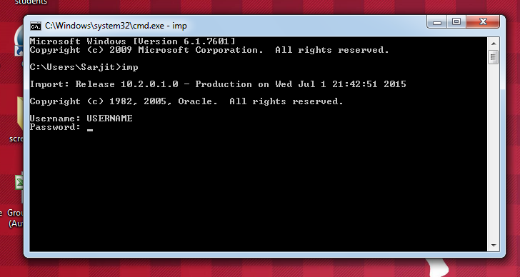
Type imp and press ENTER
It will ask for username and password
USERNAME is eshopping and PASSWORD is nolin

Slide 11
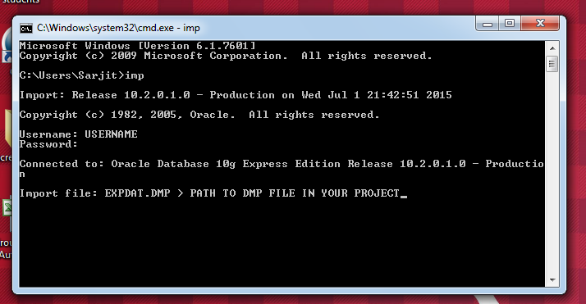
Then it will ask for the path of .dmp file. Your project has a dmp file copy paste that path here and press ENTER

Slide 12
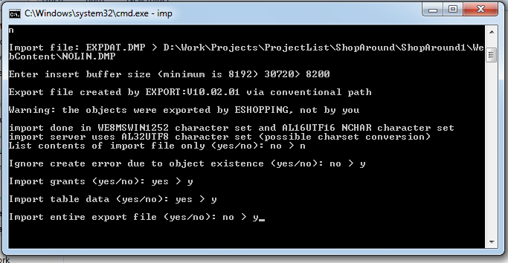
Then it will ask for buffer size . Type 8200 and press Enter
Then you get five options. Enter ‘n’ in the first option and ‘y’ in the rest as shown in the image.

Slide 13
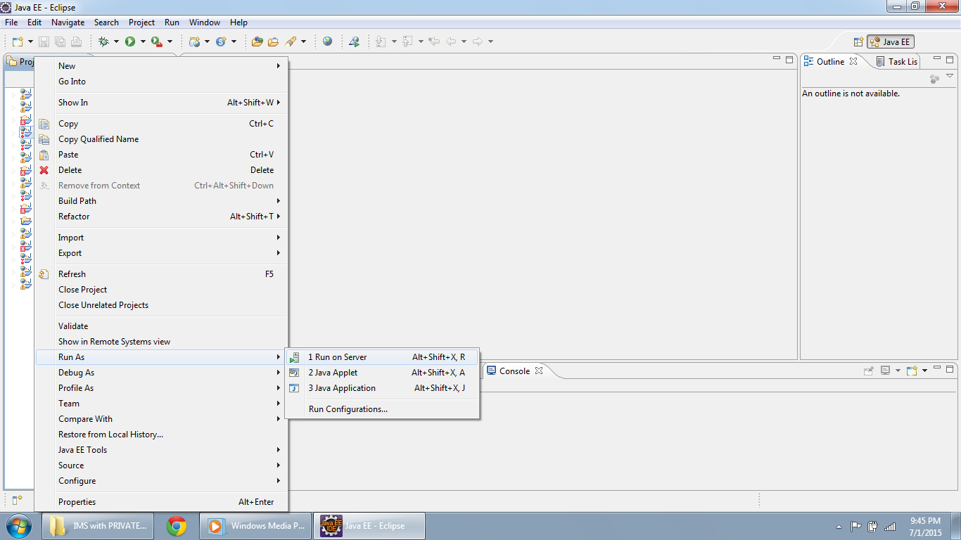
Click on ‘Run On Server’

Slide 14
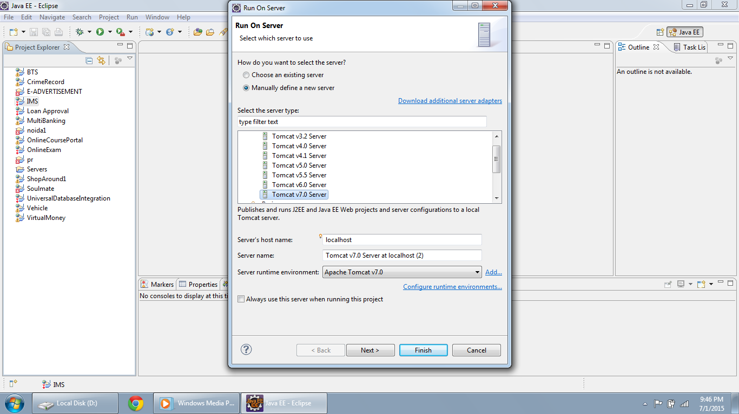
If this is your first project and you are running it for the first time you will have to make a server.
Choose Tomcat 7.0 in Apache and click on Next. Then it will ask you to browse to the server folder.
Click finish after that and you can run your project.

